Slide 1

PMTEAM www.pmteam.in
SHAPING FUTURE
गुरुर्ब्रह्मा गुरुर्विष्णुः गुरुर्देवो महेश्वरः ।
गुरुः साक्षात् परब्रह्म तस्मै श्रीगुरवे नमः ॥
Notes:
DEFENCE THEME ARMY NAVY AND AIR-FORCE LOGOS

Slide 2

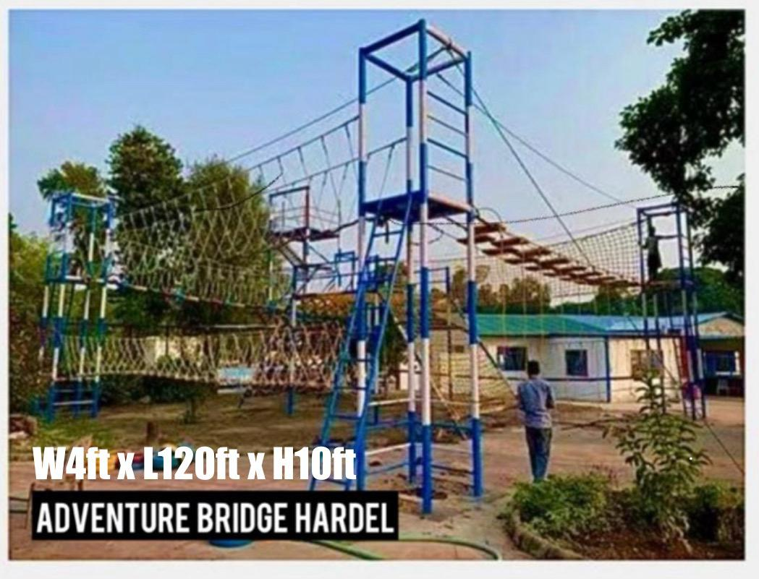
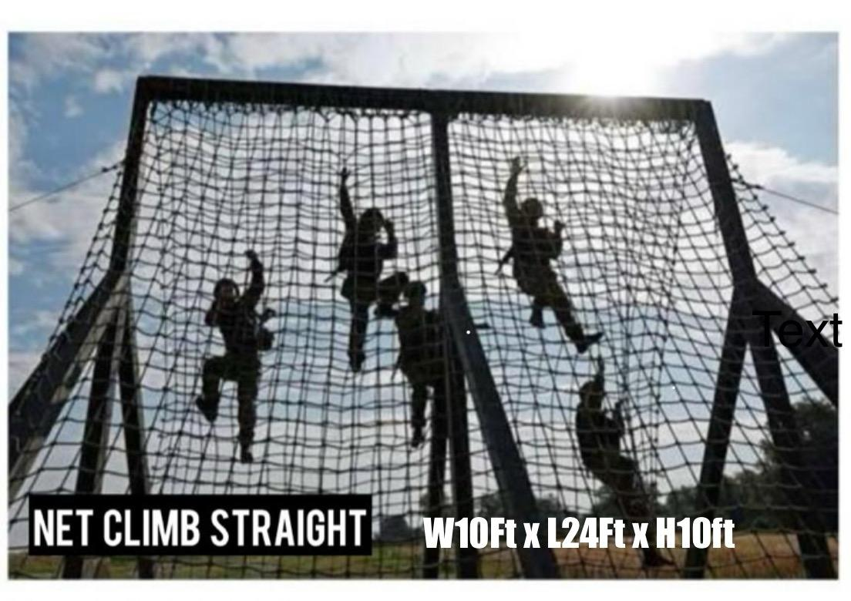


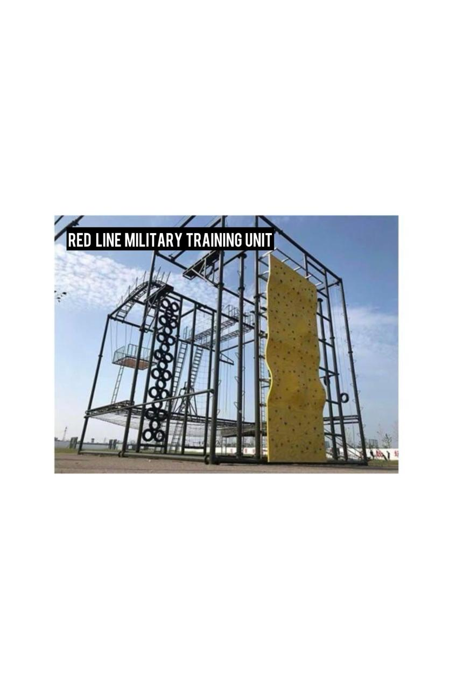
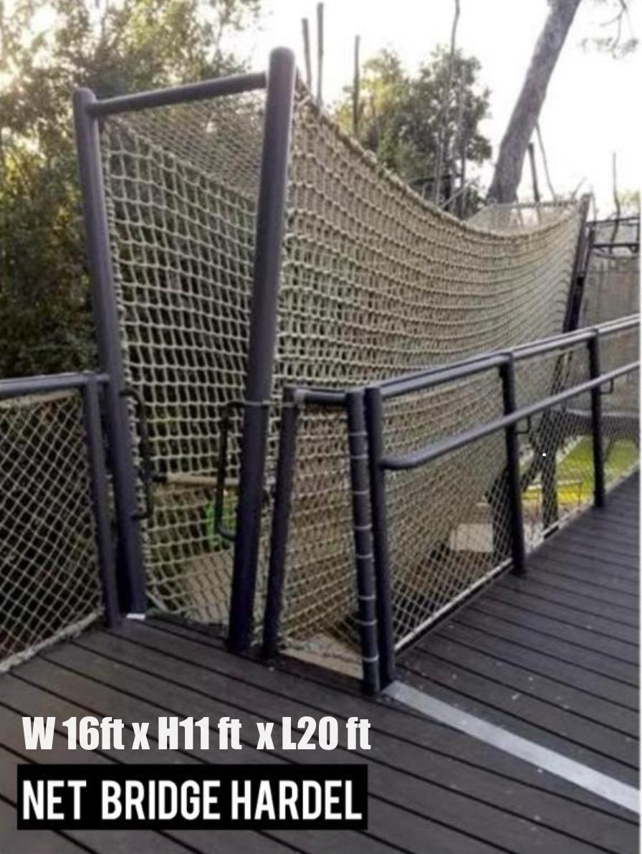

Slide 3
OUR MISSION
PRE- MILITARY TRAINING SETUPS IN EVERY DISTRICT ACROSS
PAN INDIA IN LINE WITH THE VISION OF VIKSIT BHARAT BY
2047
TO INSPIRE & PREPARE STUDENTS FOR CAREER IN DEFENCE INLINE WITH CENTRAL POLICY OF AGNIVEER
TO INSTILL DISCIPLINE COURAGE AND LEADERSHIP VALUES
TO PROMOTE AWARENESS OF DEFENCE CAREER OPPORTUNITIES
TO REDUCE SCREEN TIME OF STUDENTS AND ALLIGN NEUROLOGICAL NETWORK SYSTEM.
BRIEF ABOUT VOCATIONAL COURSES INLINE WITH NEP-2020 UNDER SAMAGRA SHIKSHA

Slide 4
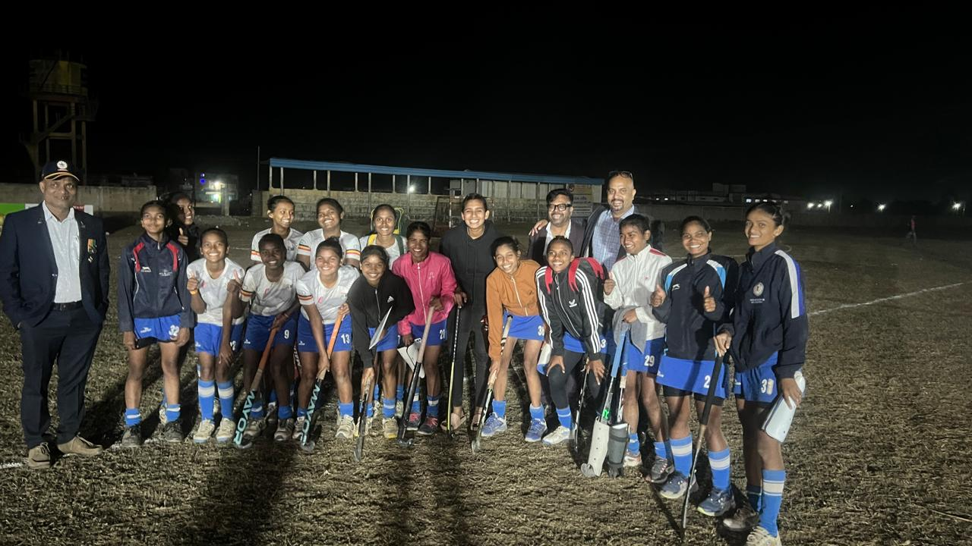
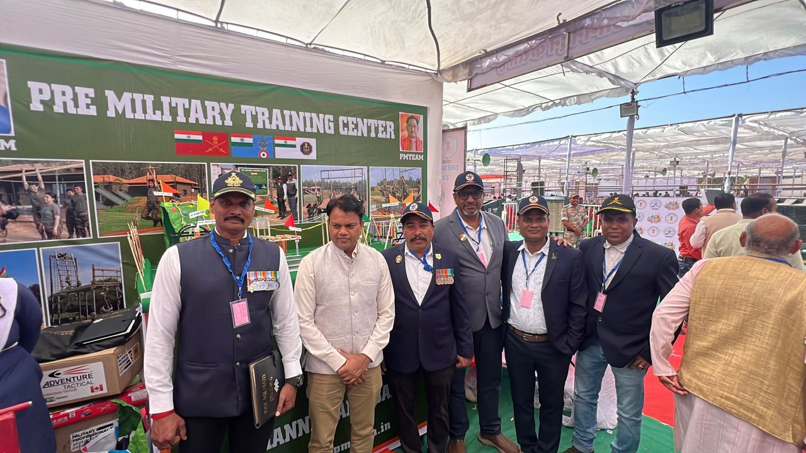
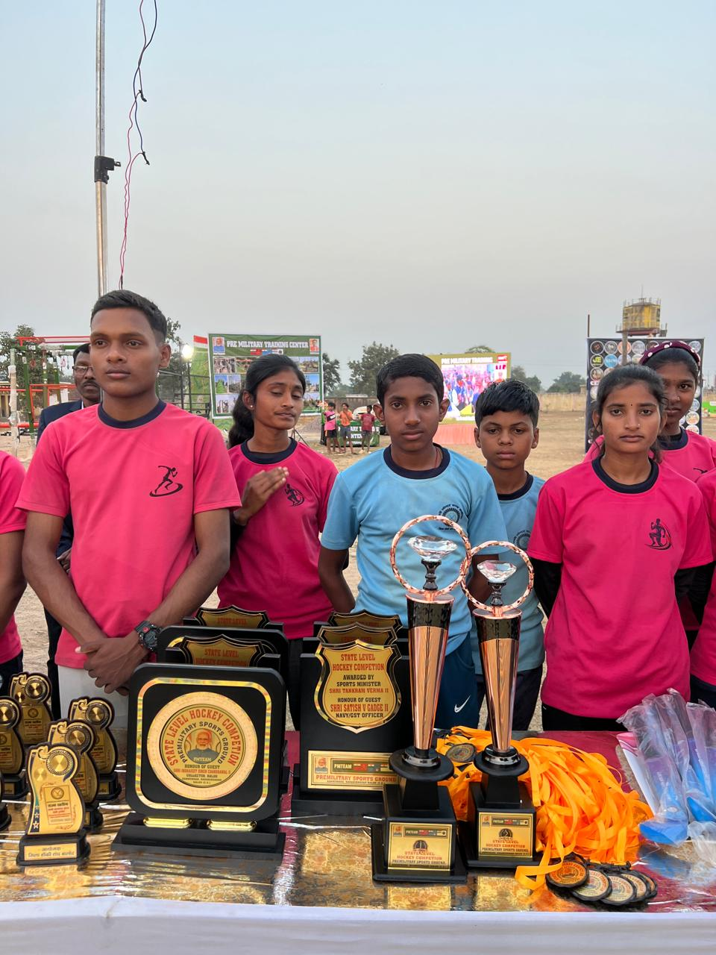
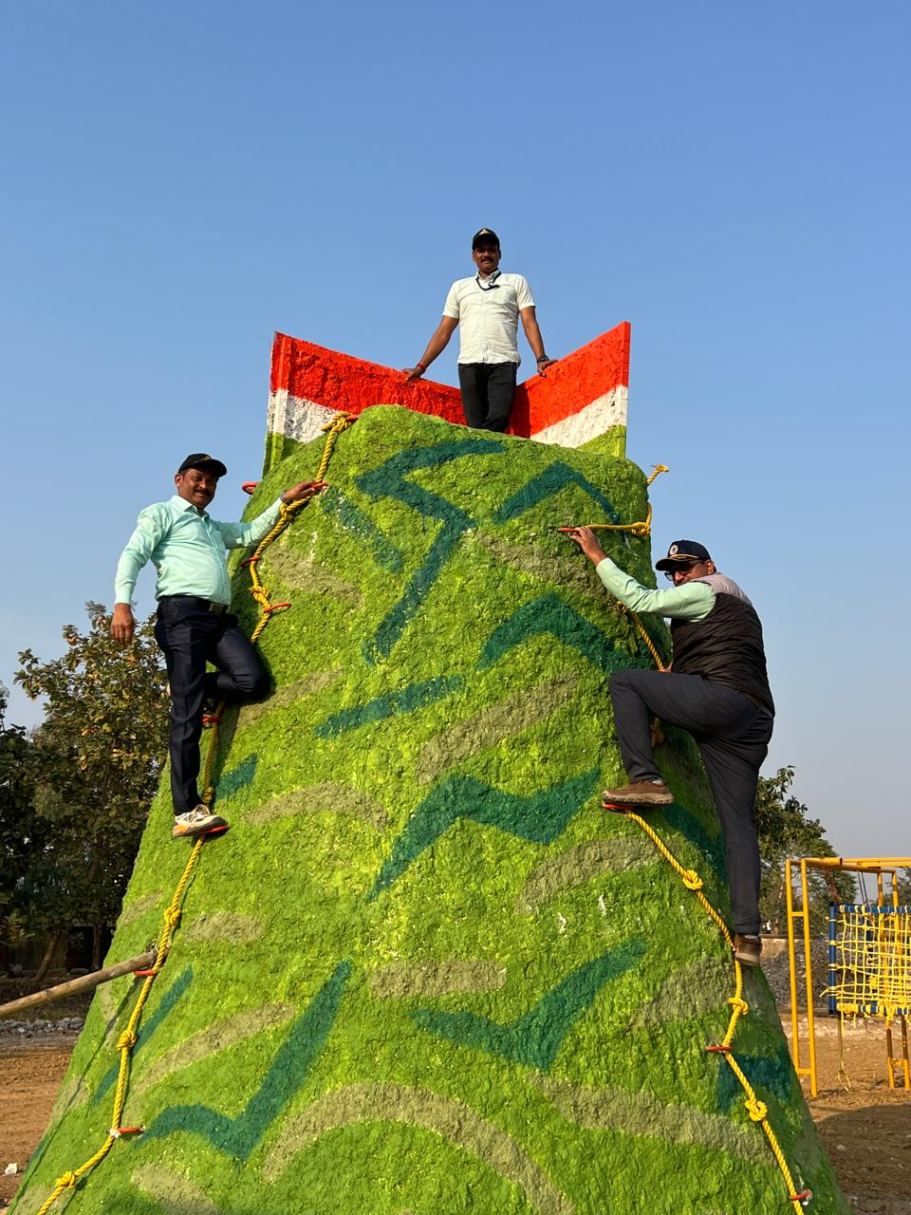
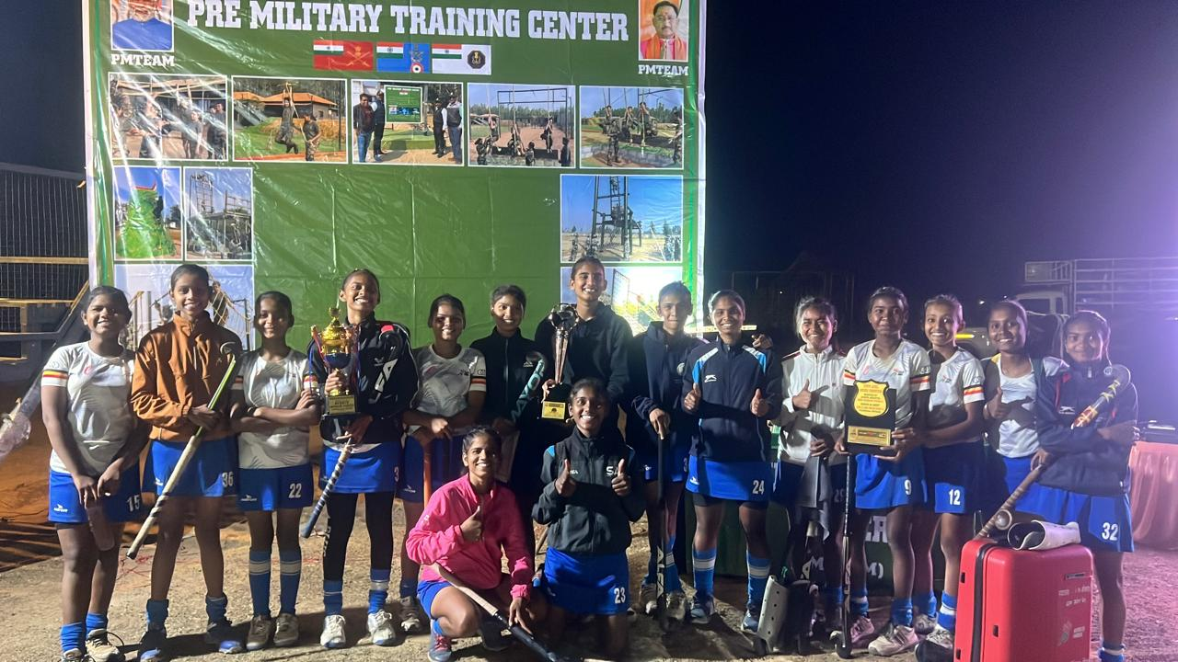
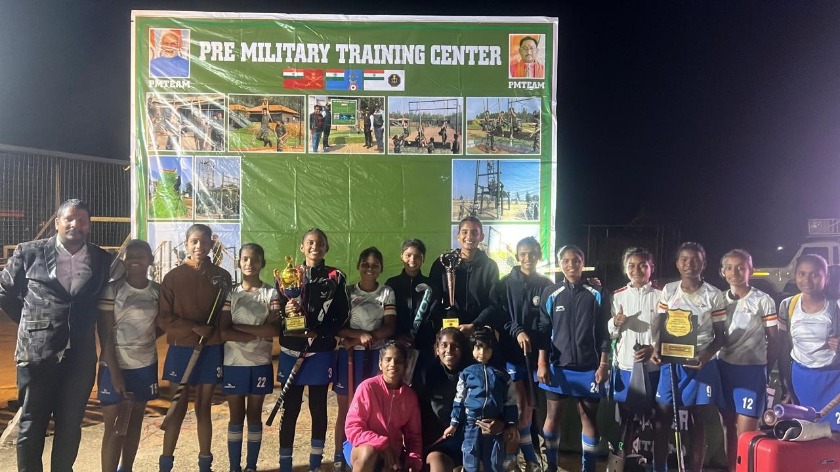
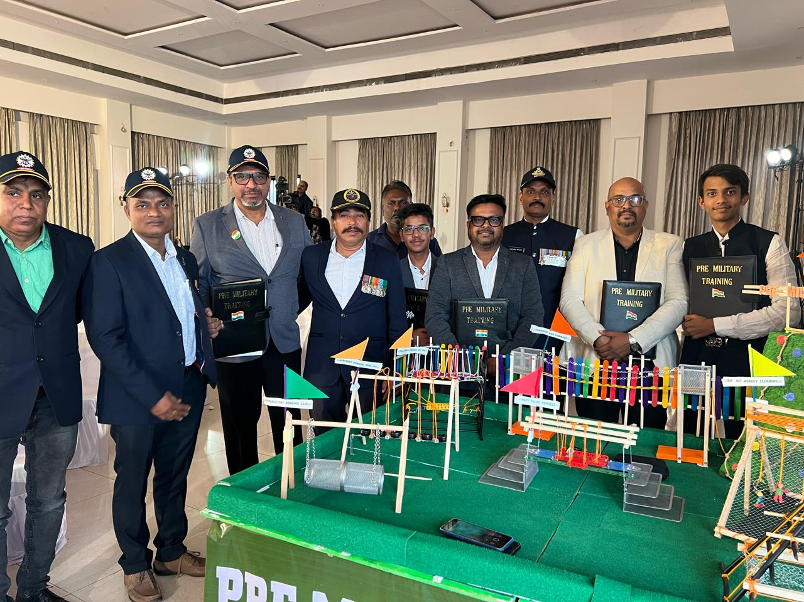

Slide 5
ABOUT PMTEAM
PIONEER IN IMPARTING PRE-MILITARY TRAINING TO RURAL & URBAN STUDENTS
EQUIPPED WITH CUSTOMISED TRAINING EQUIPMENTS
TRAINING BY EXPERIENCED INSTRUCTORS FROM ARMY, NAVY & AIR-FORCE.
MANUFACTURER OF SCIENTIFIC EQUIPMENTS FOR DIVYANG JAN ETC.
ALSO CONDUCT:
MOTIVATIONAL LECTURES
CAREER COUNSELLING
BRIEF ABOUT VOCATIONAL COURSES UNDER SAMAGRA SHIKSHA that translates
to Holistic/Comprehensive Education, referring India’s flagship scheme, aligning with
NEP 2020 goals.
PROMOTION OF AGNIVEER
GUIDANCE FOR NCC ENROLLMENT
THAT COSTS US SAME WE CHARGE

Slide 6
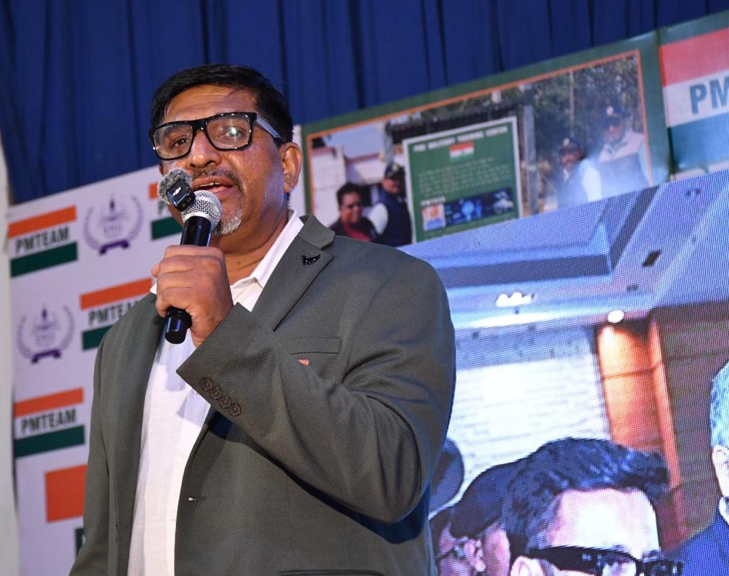
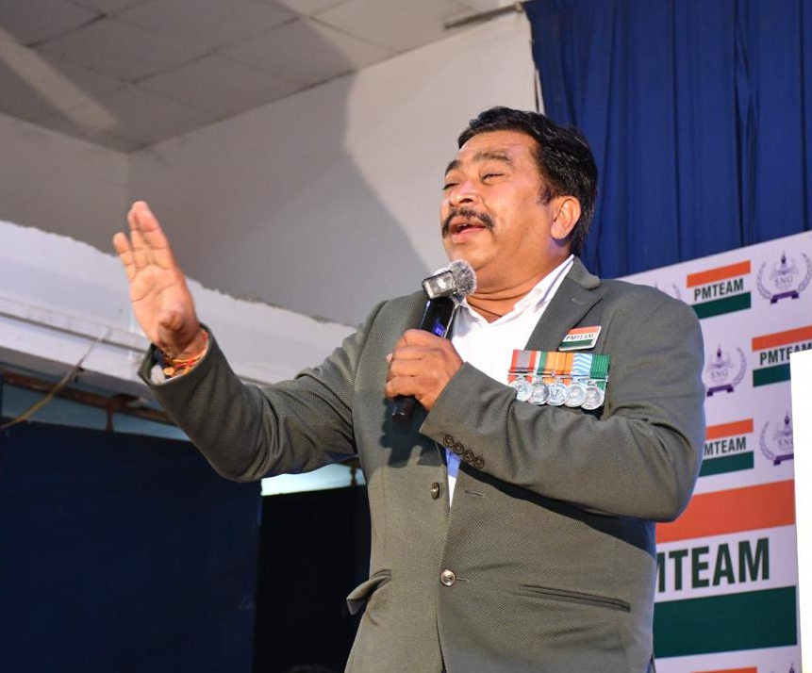
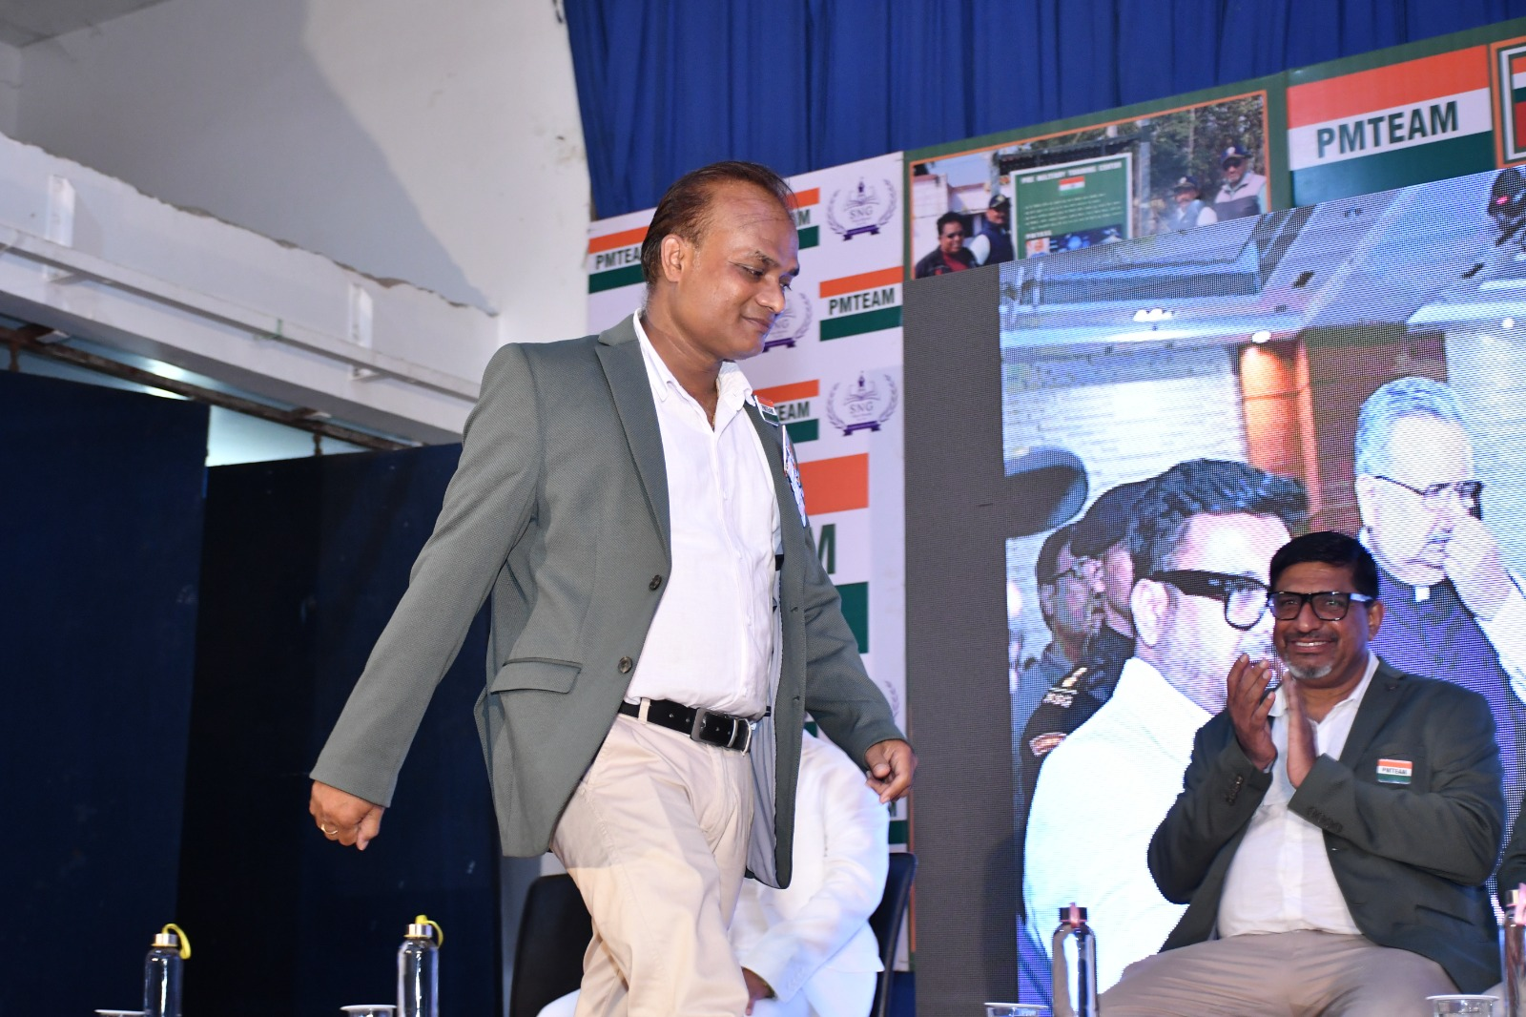
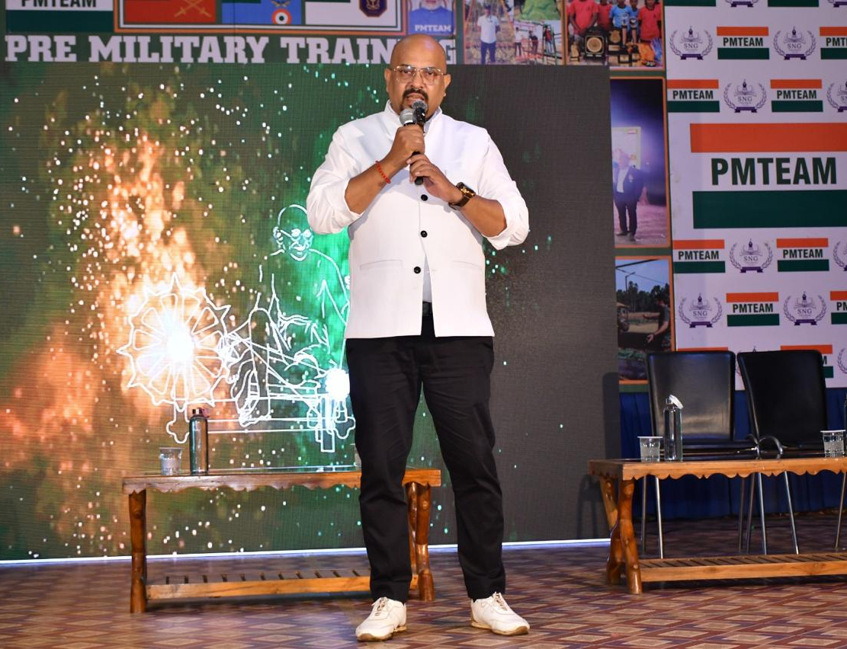
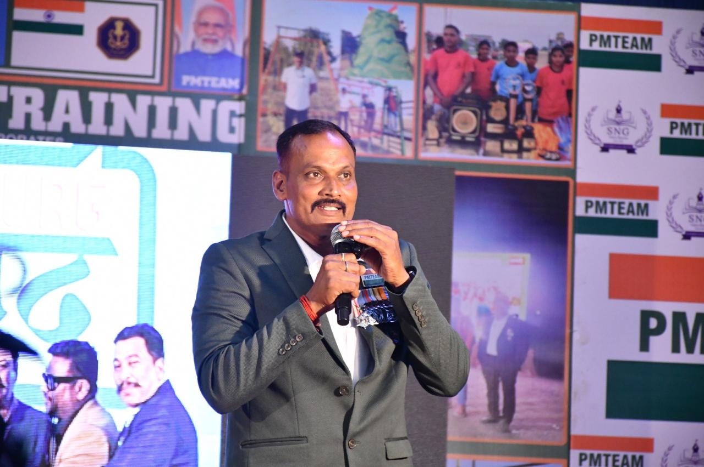
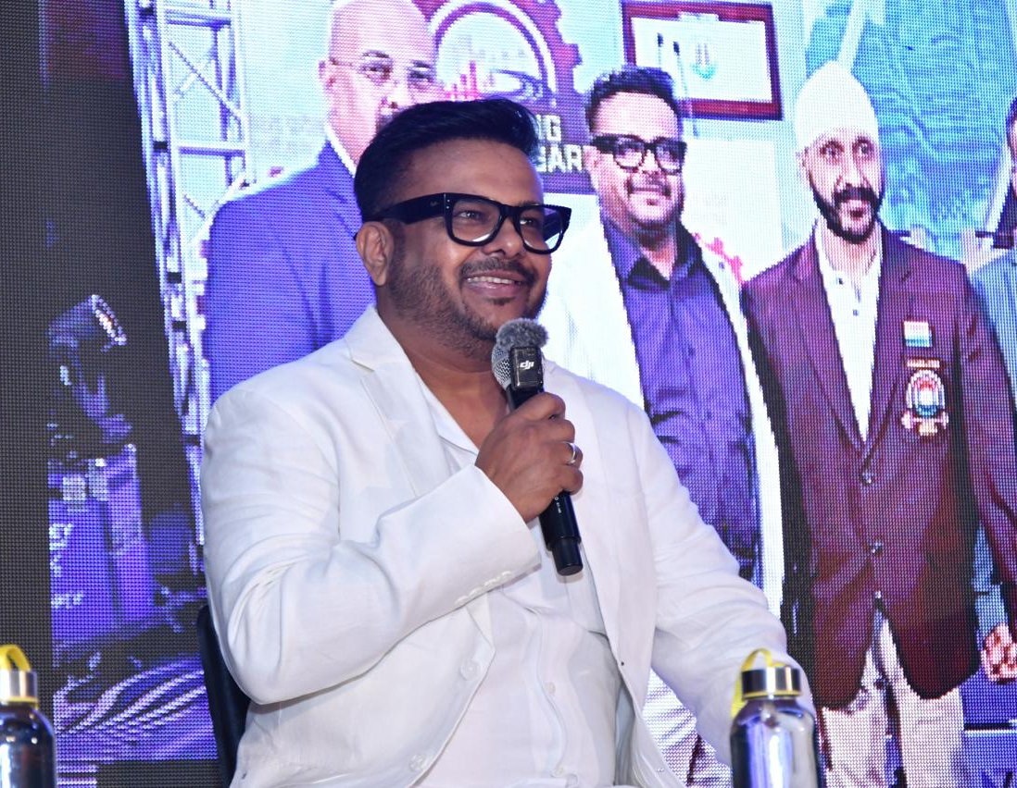
SANJAY DANDONA
SATISH VINAYAK GADGE
DINESH KUMAR SHARMA
RAJU HIRWANI
RAJNISH SINGH
ANUJ PRASAD SINGH
PMTEAM DIRECTORS

Slide 7
INVITATION BY GOVERNANCE/ADMINISTRATION/
CORPORATES /COLLEGES/ SCHOOLS
PMTEAM OPERATES AFTER INVITATION ONLY
INVITATATION LETTER MENTIONING DATE, TIME & VENUE AT LEAST FIFTEEN DAYS IN ADVANCE.
PROPASAL DOCUMENT IS SENT BY PMTEAM
CONFIRMATION OF PROPOSAL
MEETING FOR SIGNATURE, SIGHT SELECTION ALONG WITH 100 % ADVANCE (NON-REFUNDABLE)

Slide 8
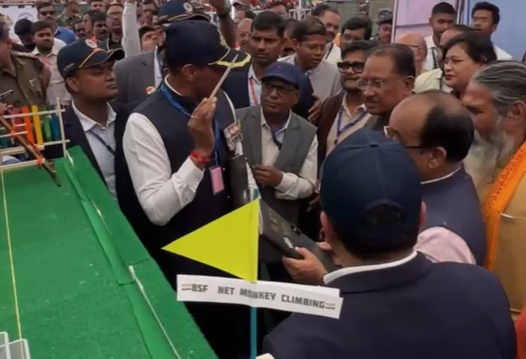
ONE OF OUR LIVE PRESENTATION TO HON. CM SIR

Slide 9
AWARDS & ACHIEVEMENTS OF PMTEAM
PMTEAM APPRECIATED BY HON. CM SHRI VISHNU DEO SAI JI
AWARDED BY HON. DY. CM SHRI ARUN SAW JI
AWARDED BY HON. DY. CM SHRI VIJAY SHARMA JI
AWARDED BY FOREST MINISTER SHRI KEDAR KASHYAP JI
AWARDED BY SPORTS MINISTER SHRI TANK RAM VERMA JI
AWARDED BY SOCIAL WELFARE MINSTER SMT. LAXMI RAJWADE JI
AWARDED BY EDUCATION MINISTER SHRI GAJENDRA YADAV JI
AWARDED BY M.P. SHRI VIJAY BAGHEL JI
AWARDED BY MP SHRI BHOJRAJ NAG JI
AWARDED BY LEGISLATIVE ASSEMBLY SPEAKER & FORMERHON. CHIEF MINISTER SHRI RAMAN SINGH JI
AWARDED BY MLA (KAWARDHA) SMT BHAVANA VOHRA JI
AWARDED BY MLA (VAISHALI NAGAR) SHRI RIKESH SEN JI
AWARDED BY MLA (DURG RURAL) SHRI LALIT CHANDRAKAR JI
AWARDED BY MLA (AHIWARA) SHRI DOMANLAL KORSEWADAJI
AWARDED BY MLA (BHANUPRATAPPUR) SHRI MANOJ SINGH MANDAVI JI
AWARDED BY MLA( BASNA ) SHRI SAMPAT AGARWAL JI
AWARDED BY MLA (ANTAGARH) VIKRAM USENDI JI
AWARDED BY MLA (KANKER) AASHARAM NETAM JI
PRE MILITARY TRAINING CENTER INAUGURATED BY MP. SHRI BRIJMOHAN AGRWAL JI & HEALTH MINISTER MP SHRI SHAYAM BIHARI JAISWAL JI (MINISTER OF HEALTH)

Slide 10
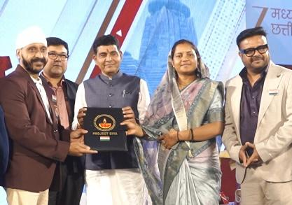
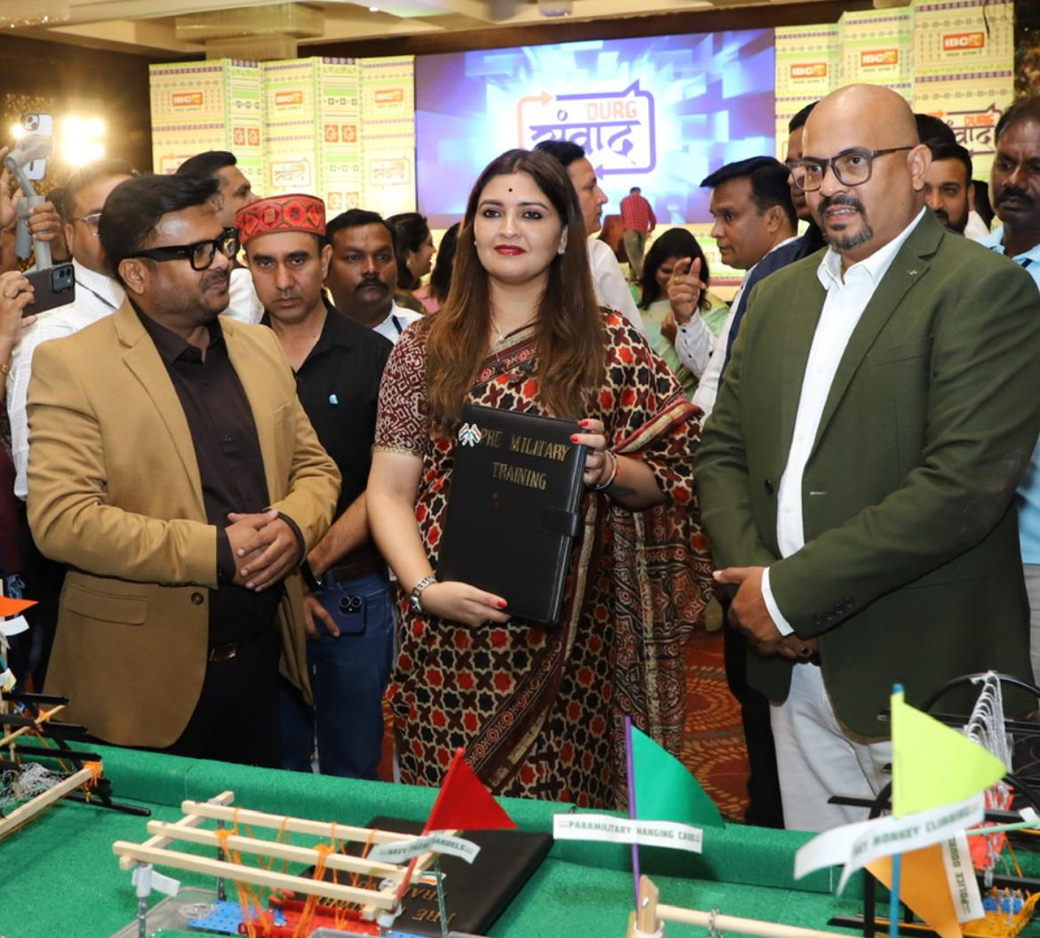
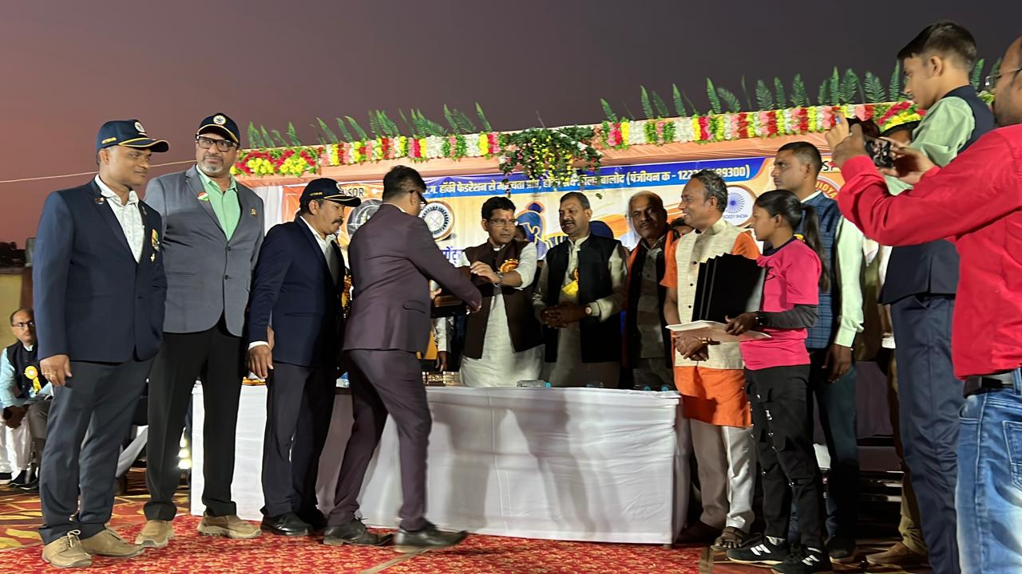
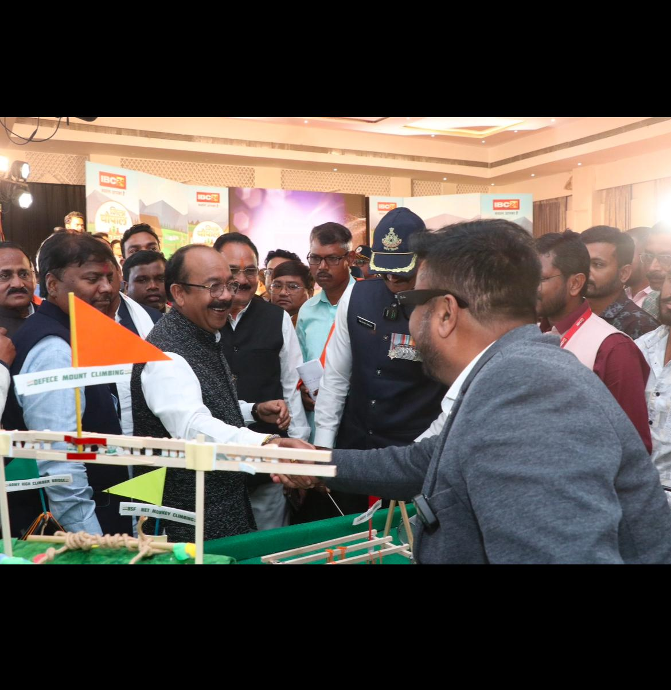
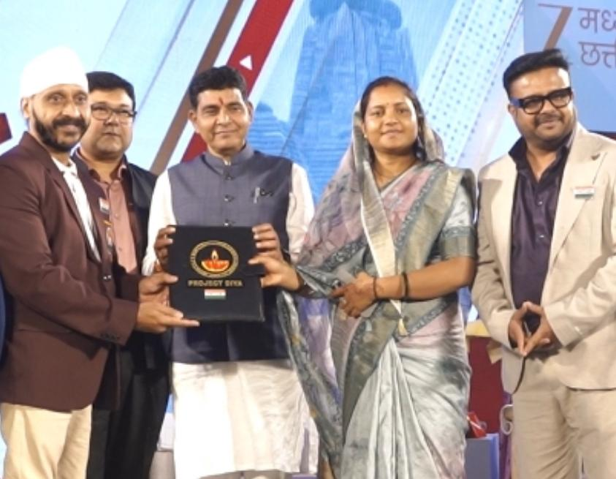
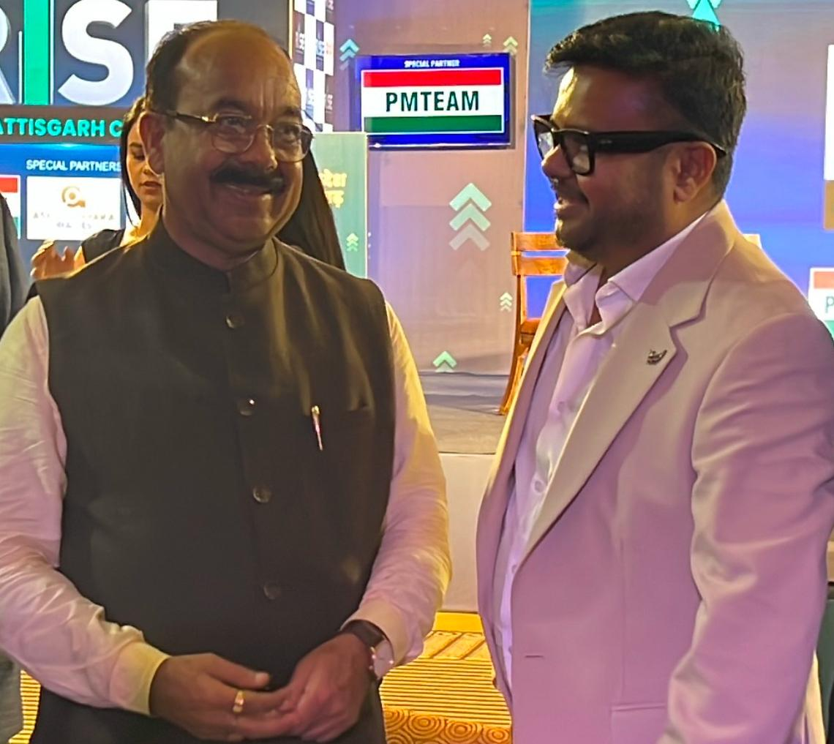
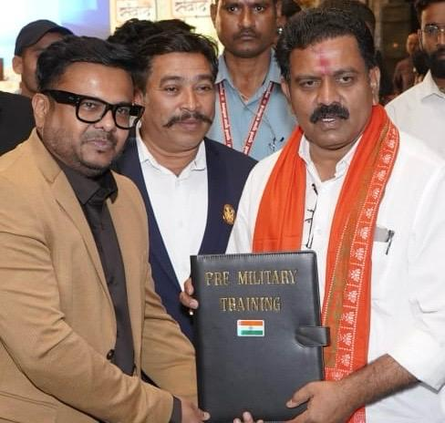
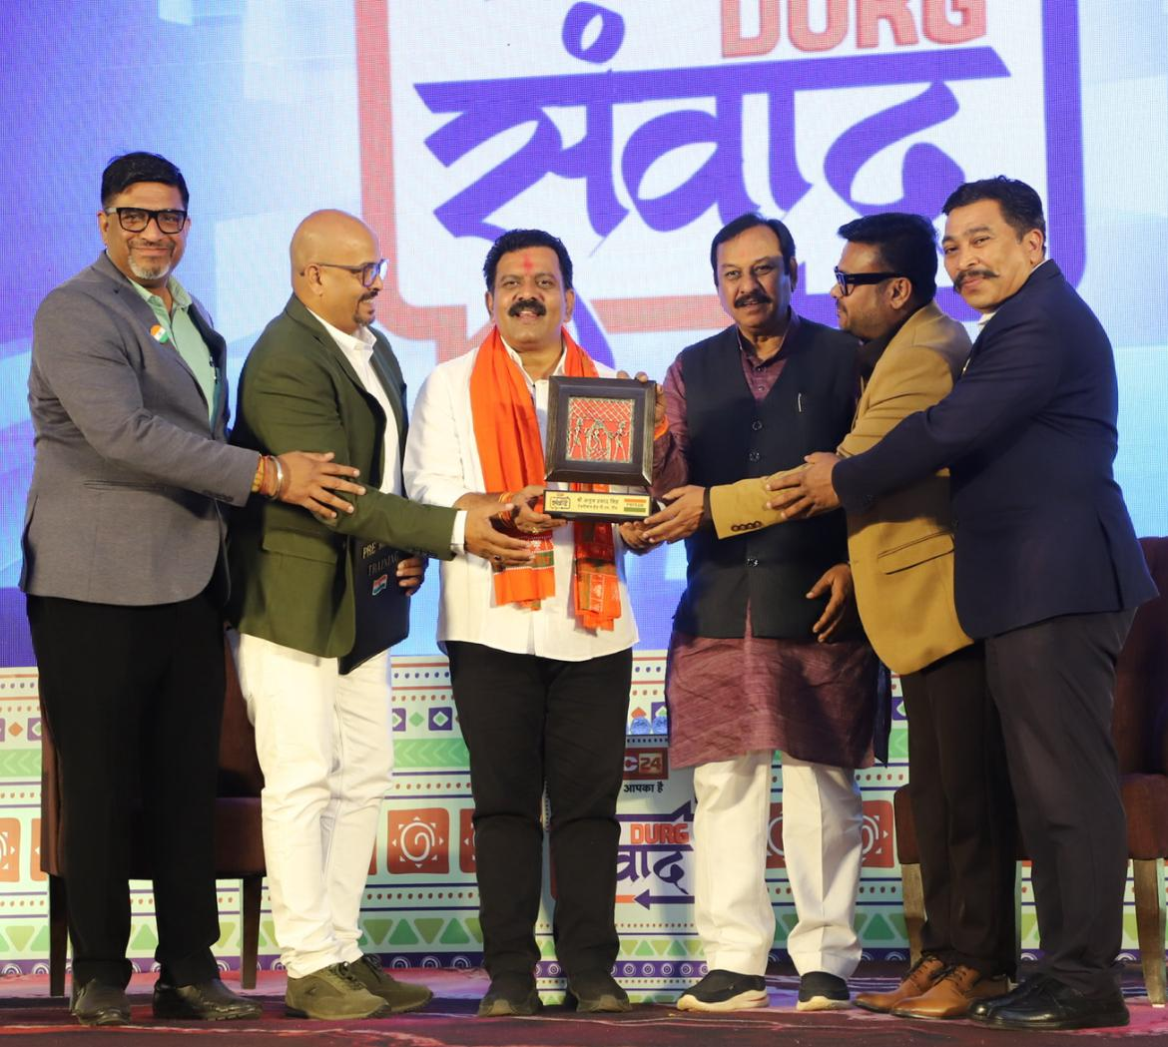
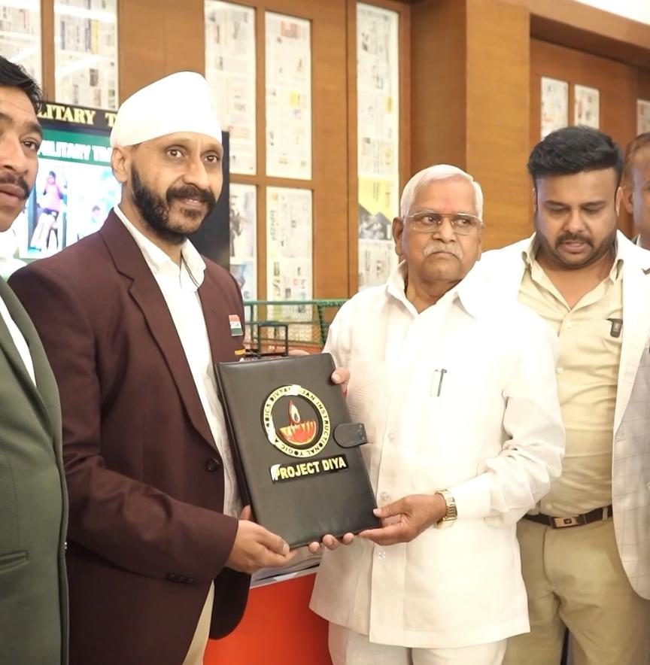
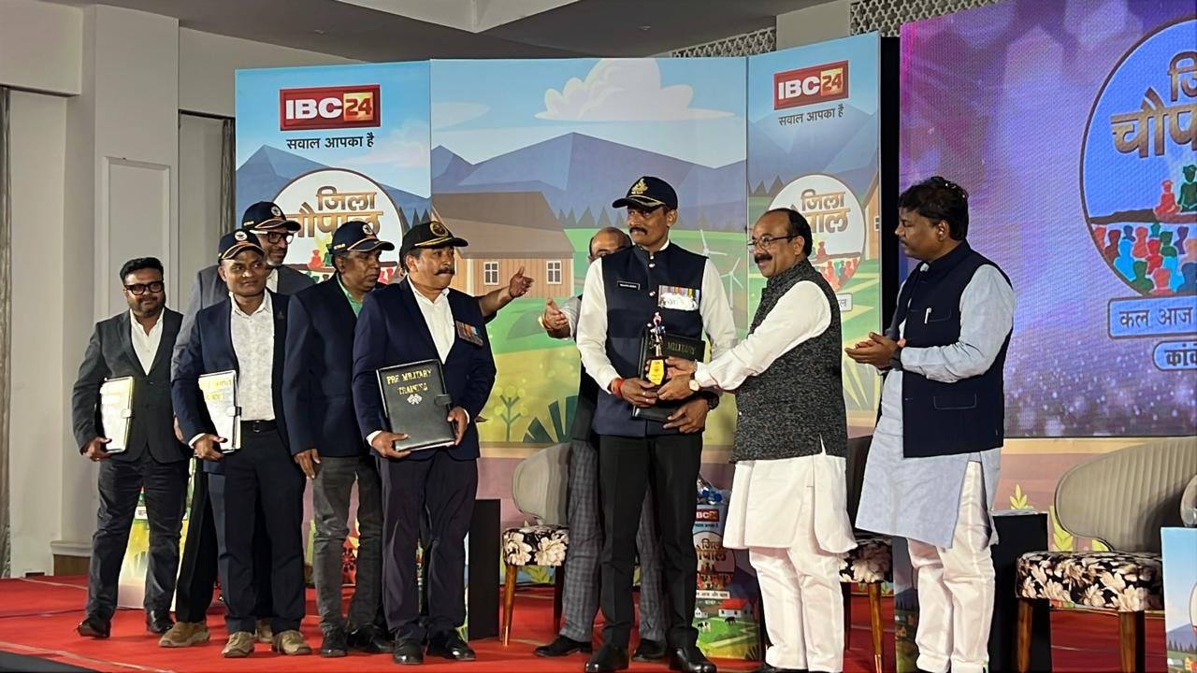
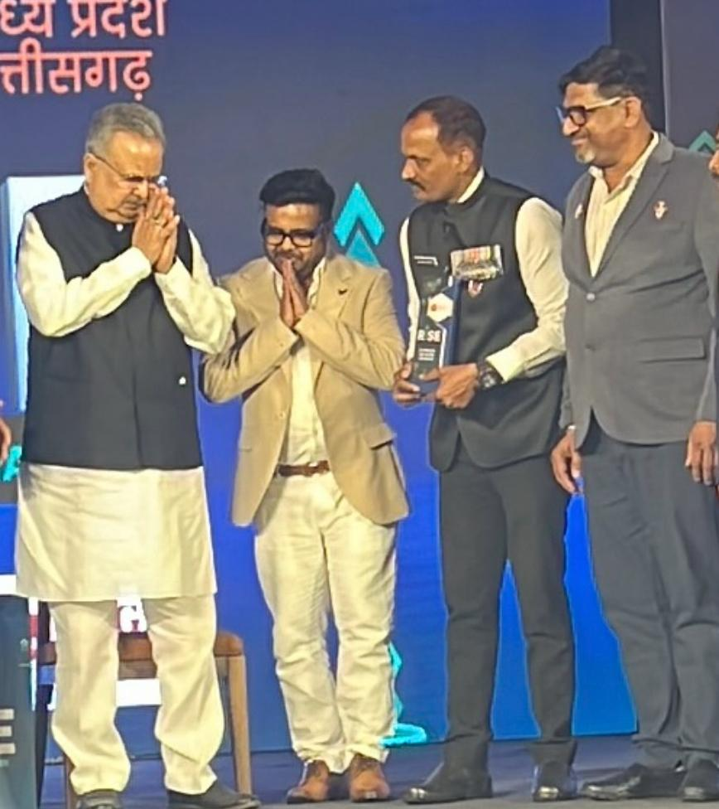
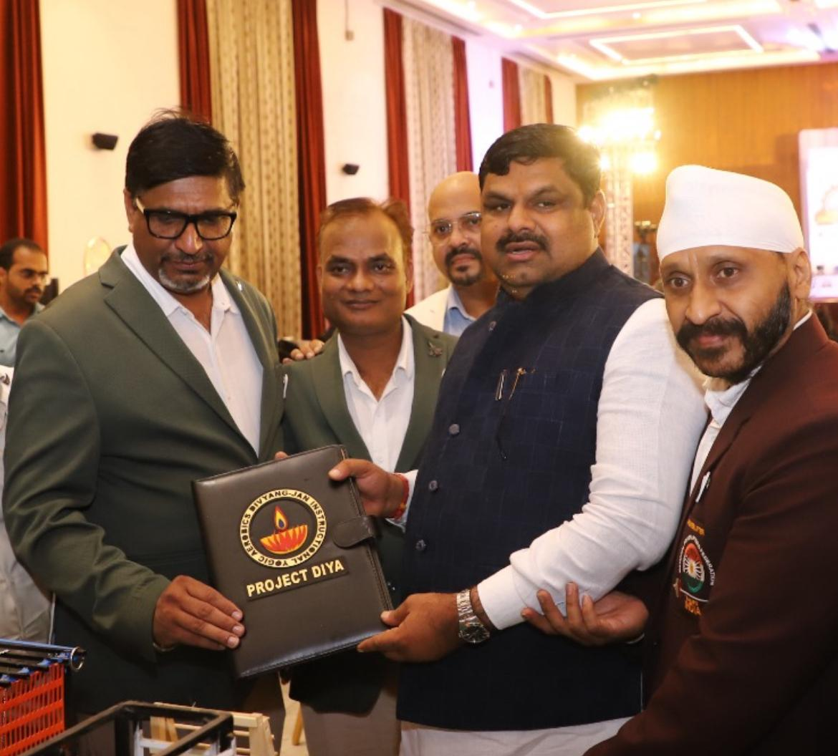
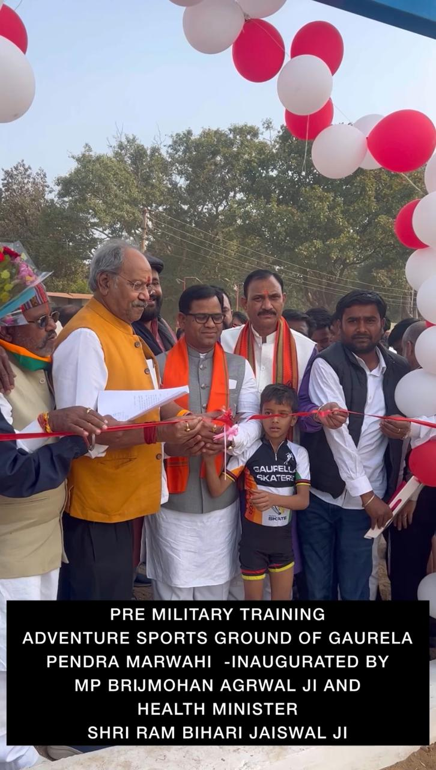
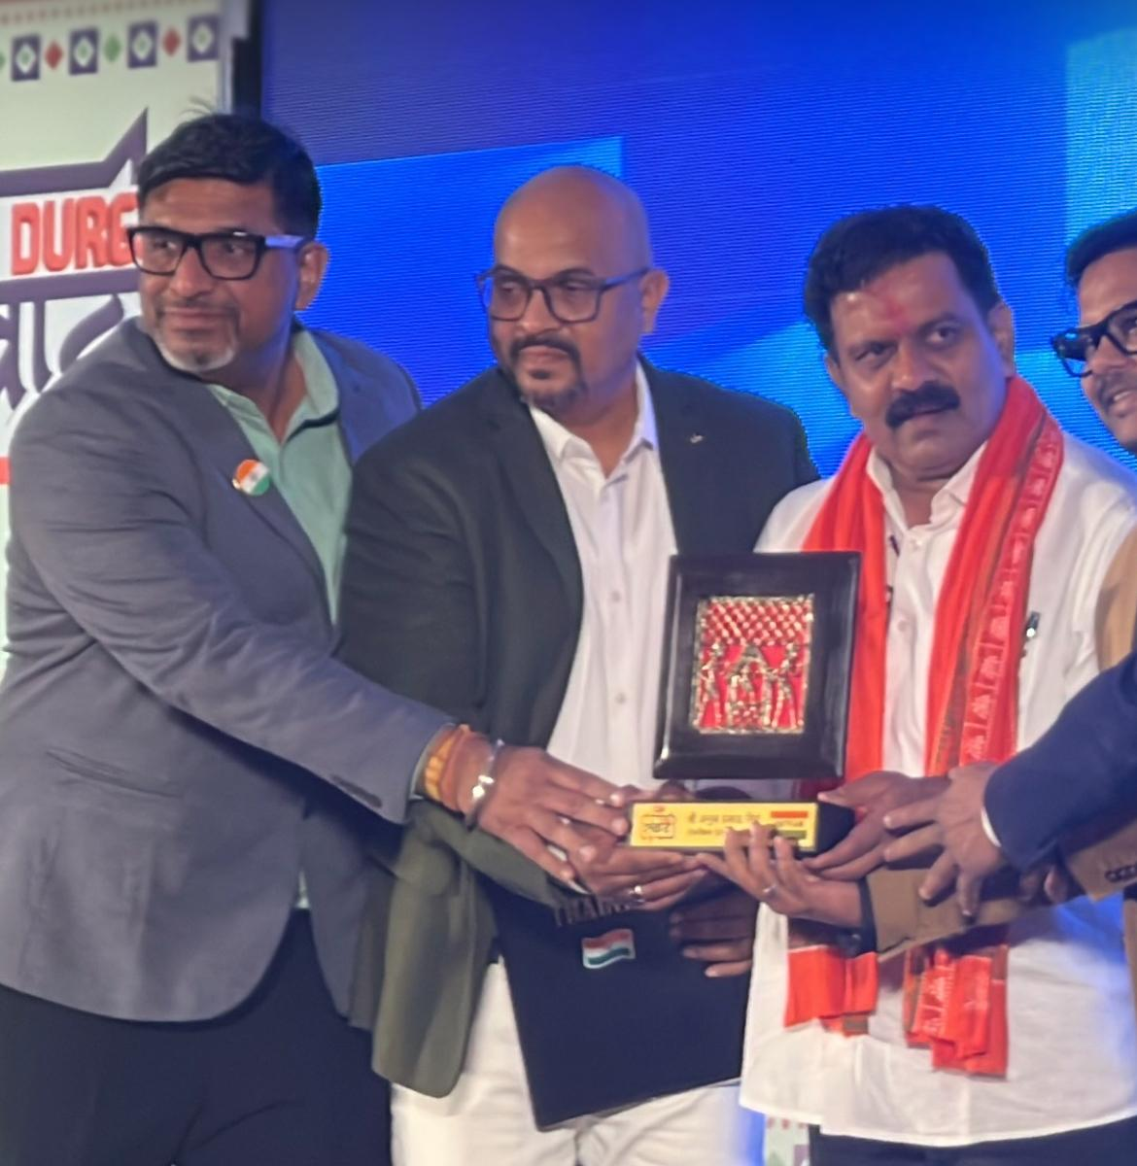
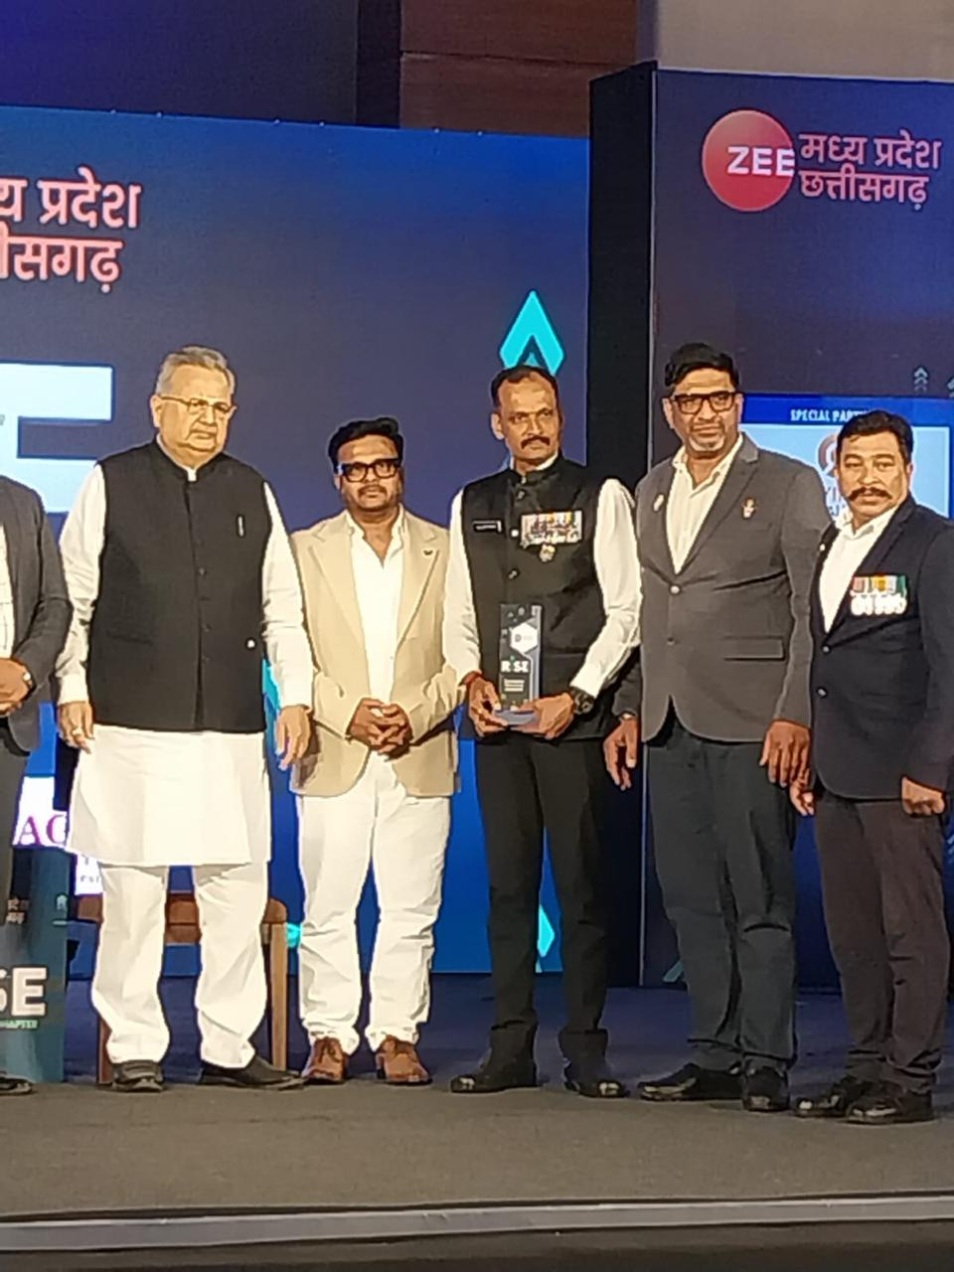
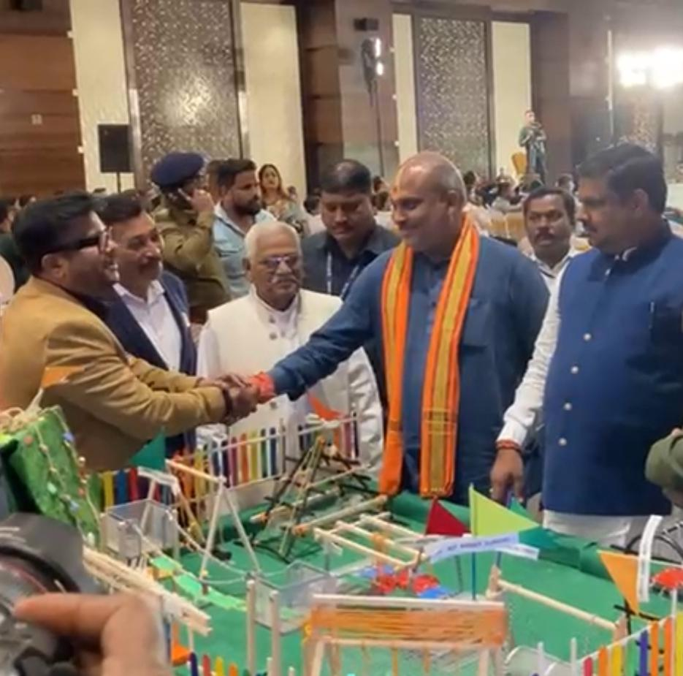
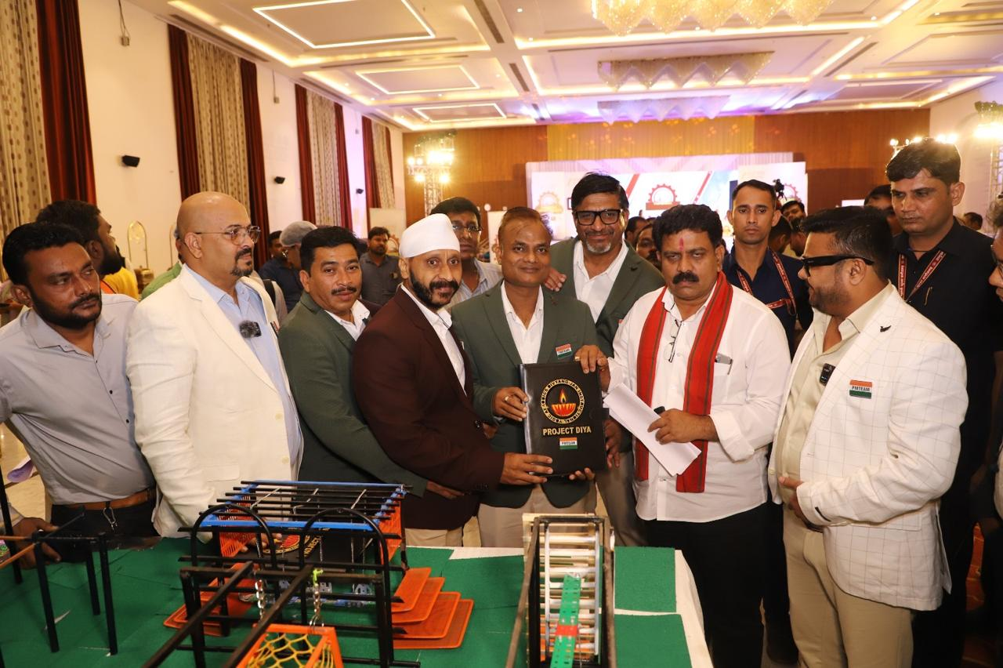
PMTEAM AWARD GALLERY

Slide 11
PMTEAM PRESENTATION
WELCOME AND EXCHANGE OF PLEASANTRIES
BRIEF INTRO OF PMTEAM
AUDIO VISUAL CLIP COMPRISING DEFENCE FORCES IN ACTION
QUESTIONNAIRE BY HOST WITH PMTEAM, SHARING EXPERIENCES
INTERACTIVE SESSION WITH STUDENTS
CAREER COUNSELLING, GUIDANCE, MOTIVATION
BRIEF ABOUT MOCKDRILL,FIRSTAID & PAD
AWARENESS OF DEFENCE OPPORTUNITIES
DISCIPLINE,PATRIOTISM & LEADERSHIP DEVELOPMENT

Slide 12
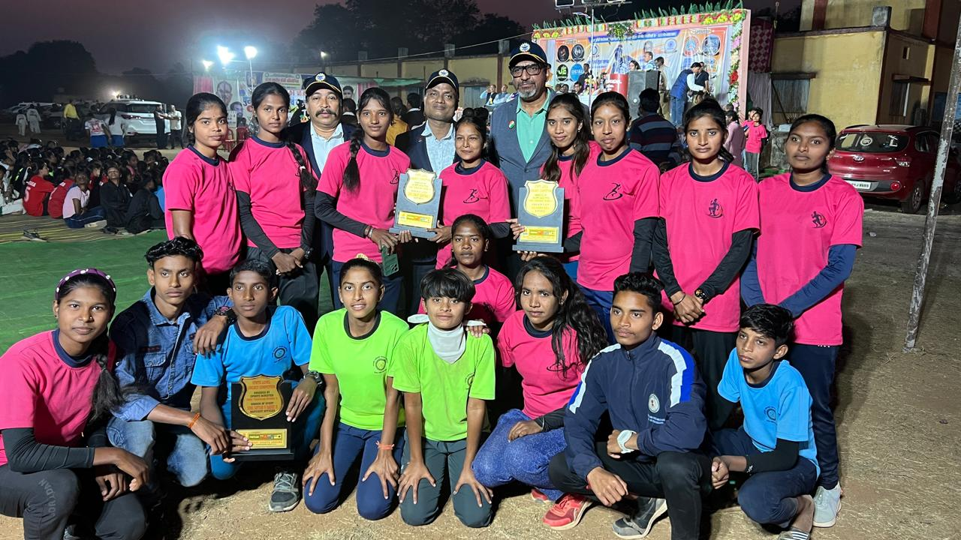
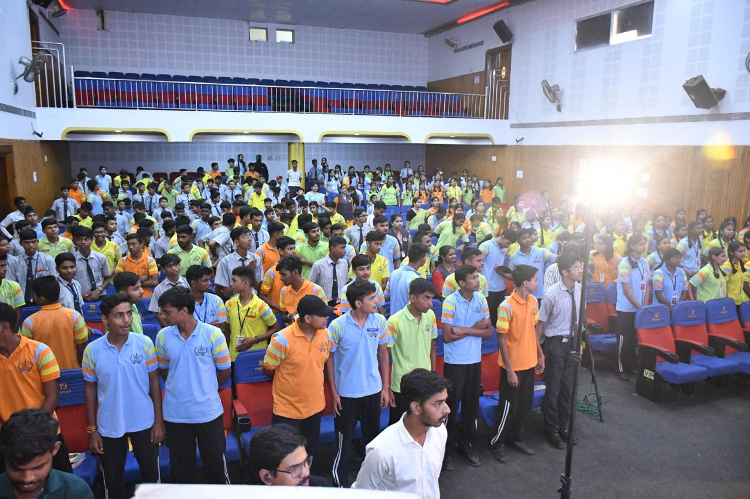
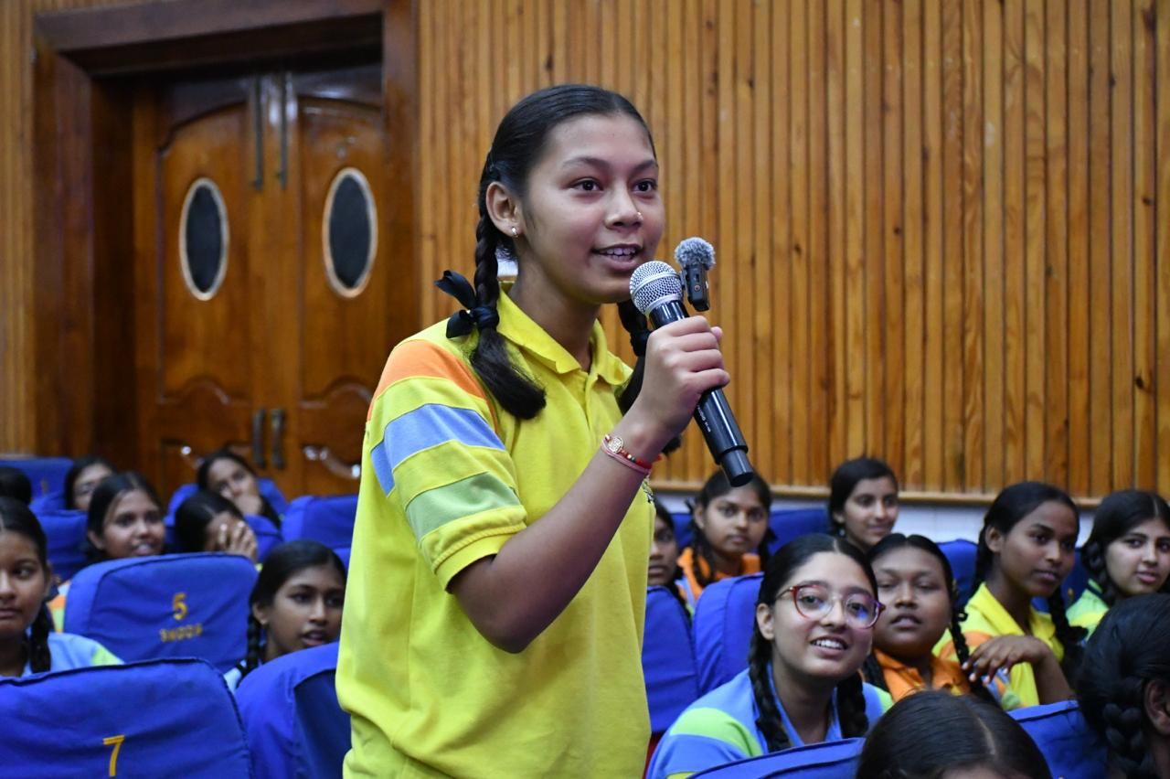
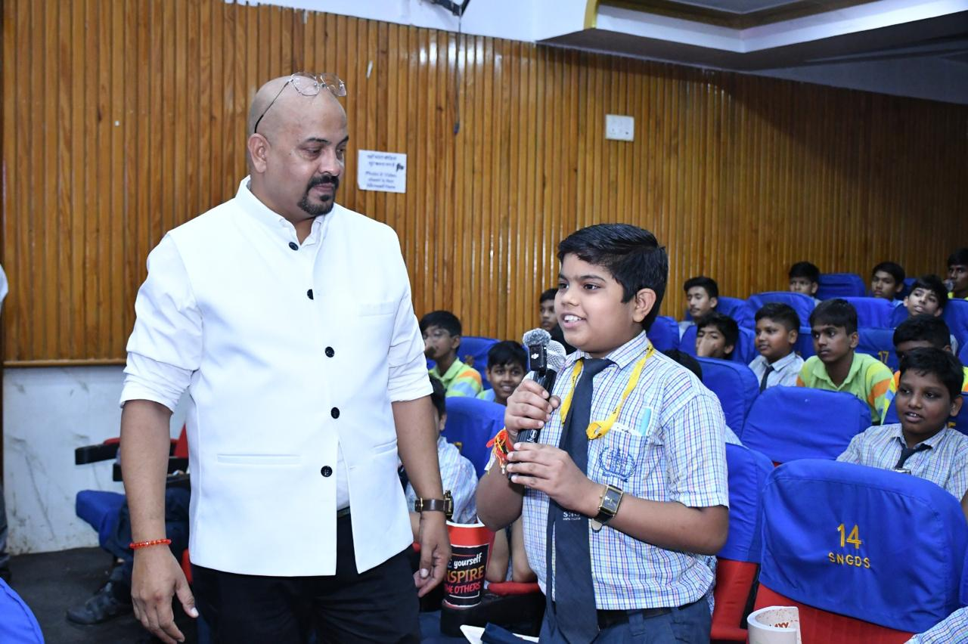
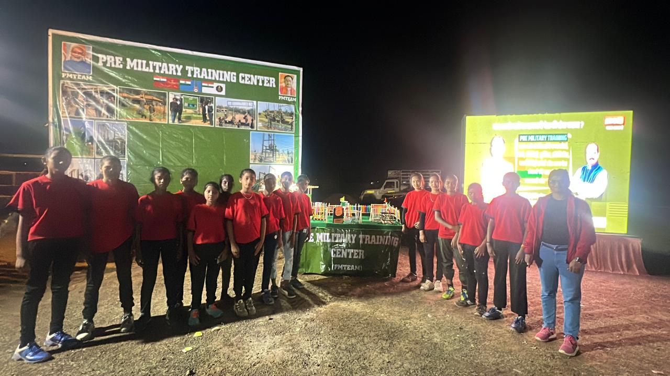
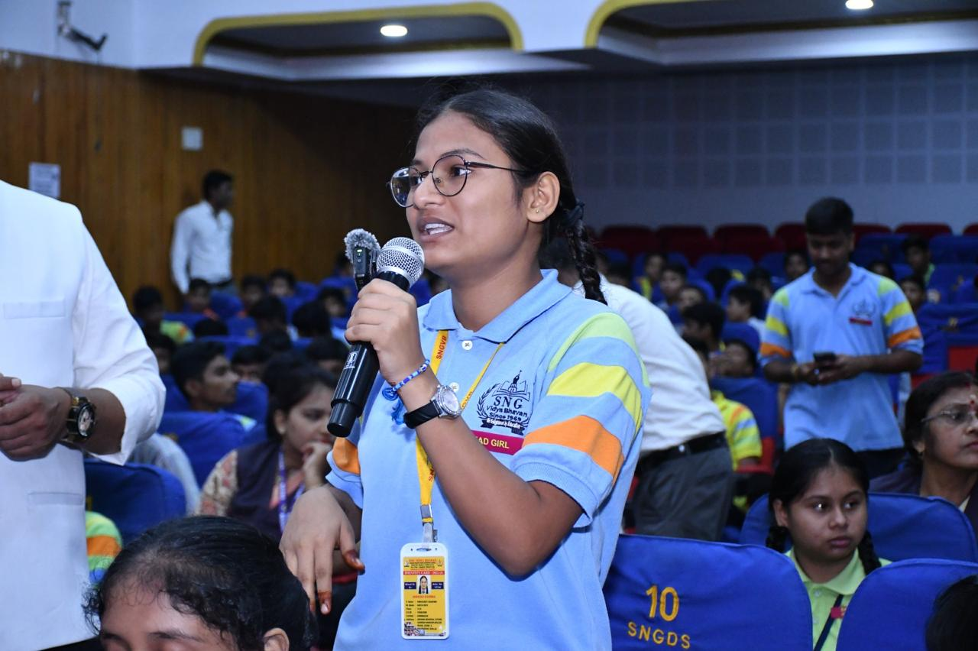
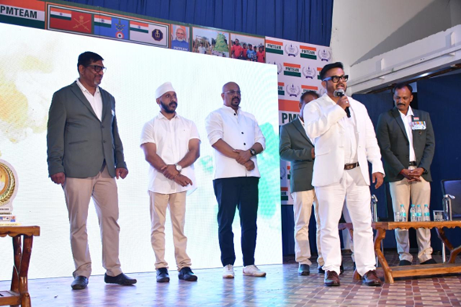
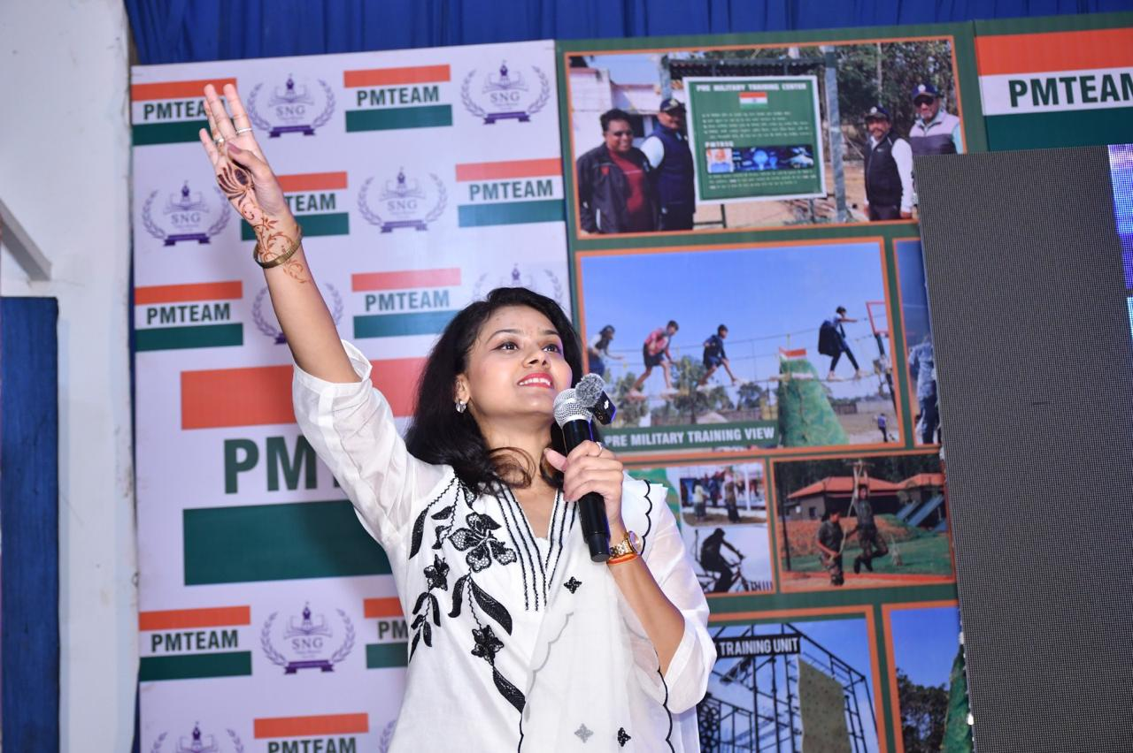
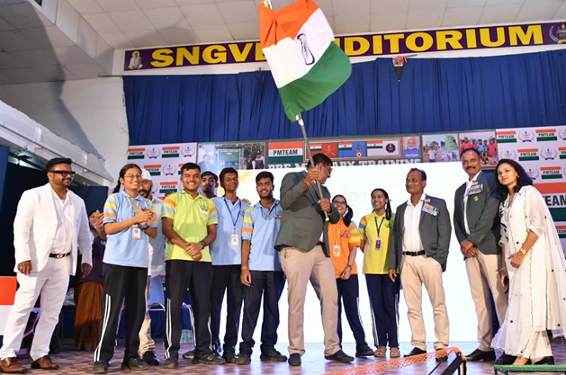

Slide 13
FEEDBACK & CERTIFICATION
STUDENT FEEDBACK FORM
EXPERIENCE OF THE EVENT
SUGGESTIONS FOR IMPROVEMENT
INTEREST IN DEFENCE CAREER
CERTIFICATE OF ACKNOWLEDGEMENT BY THE HOST AND THEIR
VALUABLE ADVICE
MOMENTO FROM PMTEAM TO THE DIGNITARY.

Slide 14
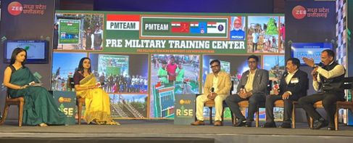
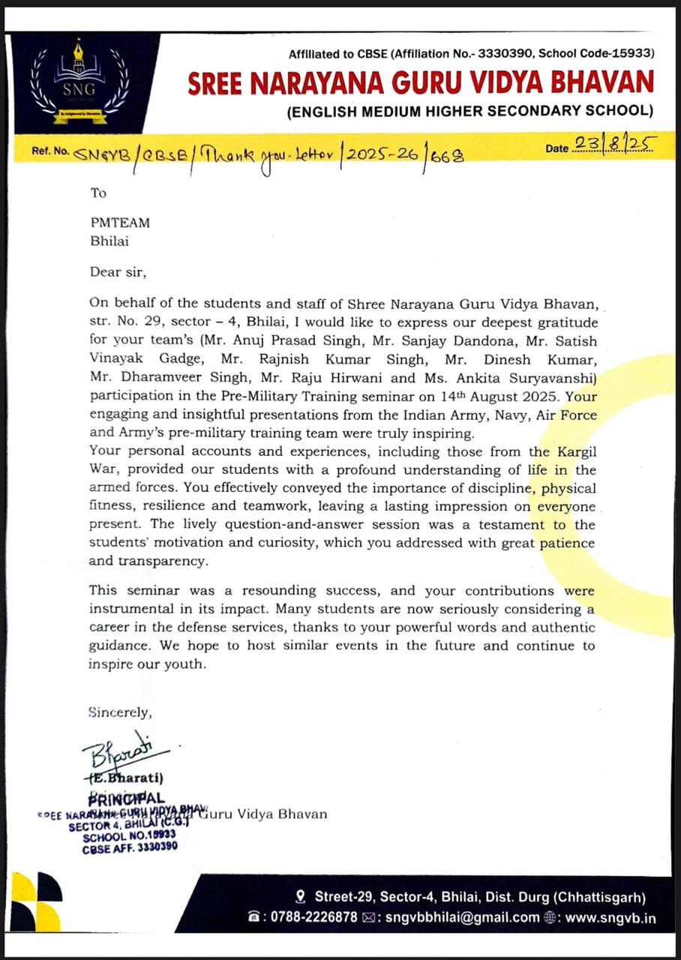
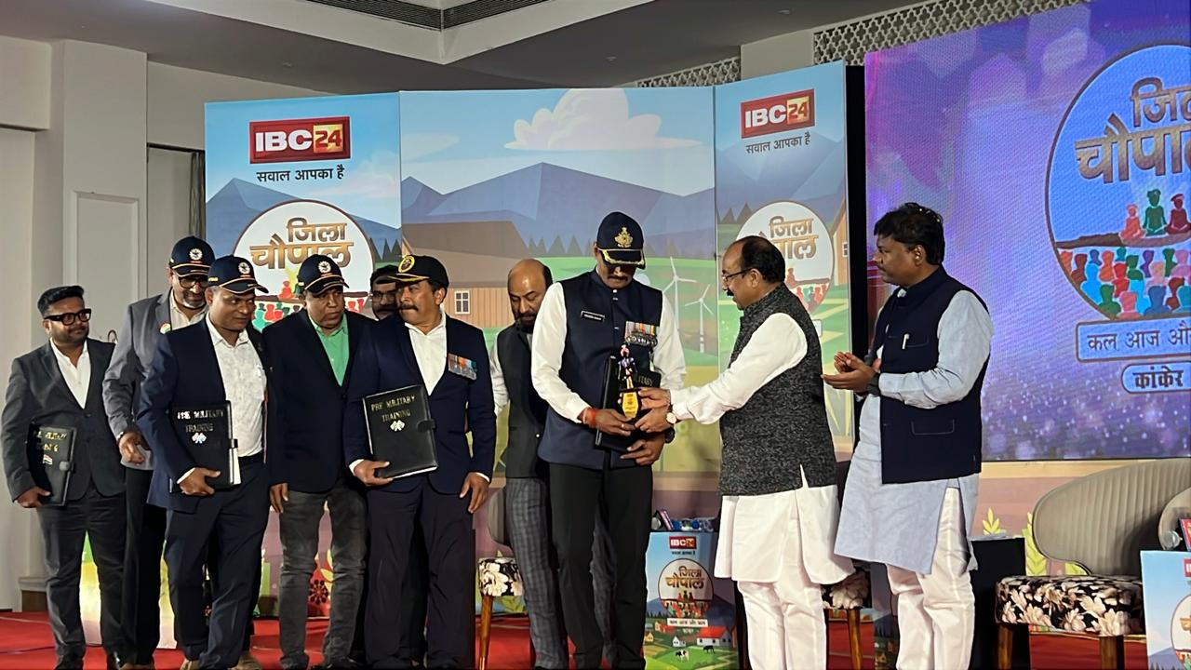
FEEDBACK & CERTIFICATIONS

Slide 15
PROCESS
PMTEAM CHARGES 101001/= RS, WHICH IS JUST A NOMINAL FEE COMPARED TO OUR INFRASTRUCTURE SET UP
BACKGROUND STAGE SETUP
08x12FT LED SCREEN+4MIC (AUDIO VISUAL CONSOLE SETUP SHRI MIC)+4 VIDEO CAMERA
(CAMCORDER CANON & TRADITIONAL) FOR DATA, STILL PHOTO CAMERA (NIKON D7500) REC.
DJ EQUIPMENTS BACKGROUND MUSIC, 4 CANON AUDITORIUM SPEAKERS & SPL SOUND
EFFECT
A CREW OF MORE THAN 25 (INCLUDING TWO ANCHORS)
SERVICE FROM OUR SIDE
REFRESHMENT, RETURN-GIFT, MOMENTO
LIVE STREAMING ON FACEBOOK,YOUTUBE, INSTAGRAM, ELCTRONIC MEDIA ZEE, IBC-24
THAT COSTS US THE SAME WE CHARGE
STRENGTH OF STUDENTS SHOULD BE BETWEEN 300 TO 400
PMTEAM IS ALSO WORKING FOR DIVYANG JANS THROUGH ITS INNOVATIVE PROJECT DIYA
MINUTES OF THE EVENT {SCHOOL DATA} ARE TAGED TO DMO, CMO & PMO
( THE SCHOOL NAME MAY SOME TIME FIND PLACE IN HON. PRIME MINISTER’S ‘MAN KI BAAT’ ALSO)

Slide 16
PMTEAM Proposal
Training, Motivating & Coaching Bright Rural and Marginalized Students
For Defence, Paramilitary & Allied Services Careers In Collaboration with Government of Chhattisgarh
SWOT analysis https://share.google/KgzCsk0lXhIXsjk1z

Slide 17
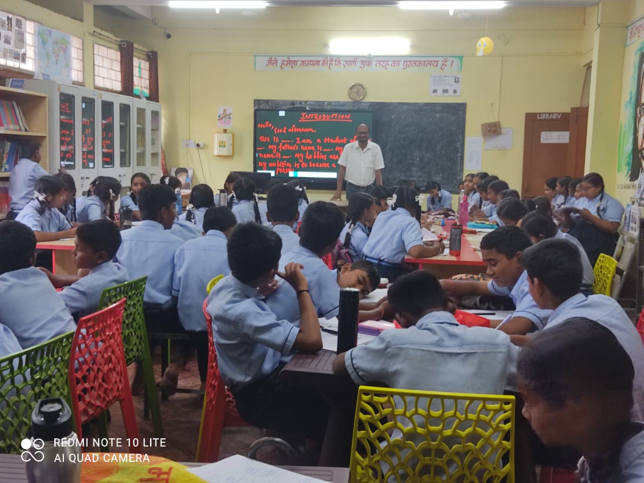

Slide 18
Introduction PMTEAM
Leading organization in Pre-Military Training & equipment installation, Operates modern coaching centres preparing youth for Defence, Paramilitary & Allied services
Plan:-Establish district-wise residential coaching centres in collaboration with Govt. of Chhattisgarh under DMF or skill development schemes Focus on rural and marginalized meritorious students

Slide 19
Objective
Provide comprehensive Pre-Military & competitive coaching to rural & economically weaker students
Prepare students for NDA, CDS, CAPF, Agniveer, Territorial Army, Police service & related exams.
Instill discipline, leadership, physical fitness, patriotism.
Establish district-level sustainable residential coaching hubs.
Enhance social and economic standards of rural youth through national service pathways

Slide 20
Selection of students
Target Group
Rural
Tibal
Marginalized communities (Class 10-12 preferred)Equal opportunity for male and female candidates.
Selection through district-level written tests and physical assessments

Slide 21
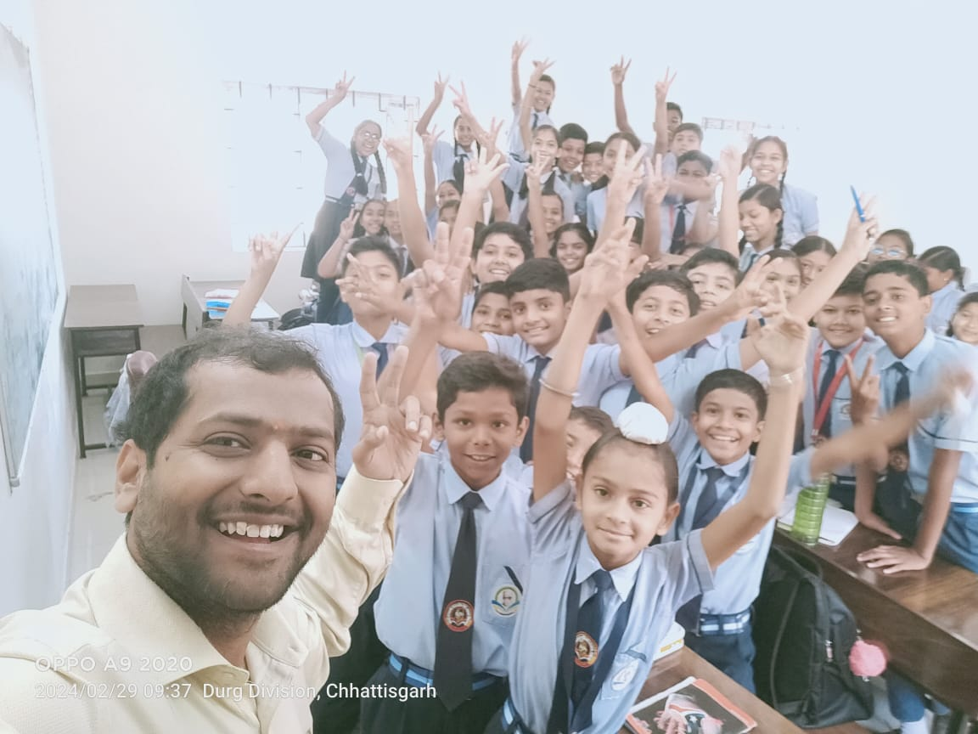

Slide 22
Training Program
12-month residential coaching for 1000 students. Academic subjects for NDA/CDS/CAPF/Agniveer exams, Intensive physical training on Pre-Military Equipment
Specialized classes:-
English, Maths, General Awareness, Reasoning, Communication, Mock tests, interviews, fitness evaluation, SSB Interview preparation by retired Defence Officers and Psychologists.

Slide 23
Infrastructure & Facilities
District-level residential centers
Smart Classrooms with audiovisual and live classes
Well-equipped physical training grounds
Safe & hygienic hostel accommodation.
Balanced nutritious meals thrice daily.

Slide 24
Staffing & Supervision
By Experienced instructors
Retired Defence officers
Physical Educators
Defence mentors
Sports scientists
PMTEAM administration coordination with District Education & Administration.

Slide 25
Monitoring & Evaluation
Academic & physical performance Tracking
Monthly reports to District Collector & State Education Department
Virtual meetings facilitated by Defence Officers
Annual program reviews for improvements

Slide 26
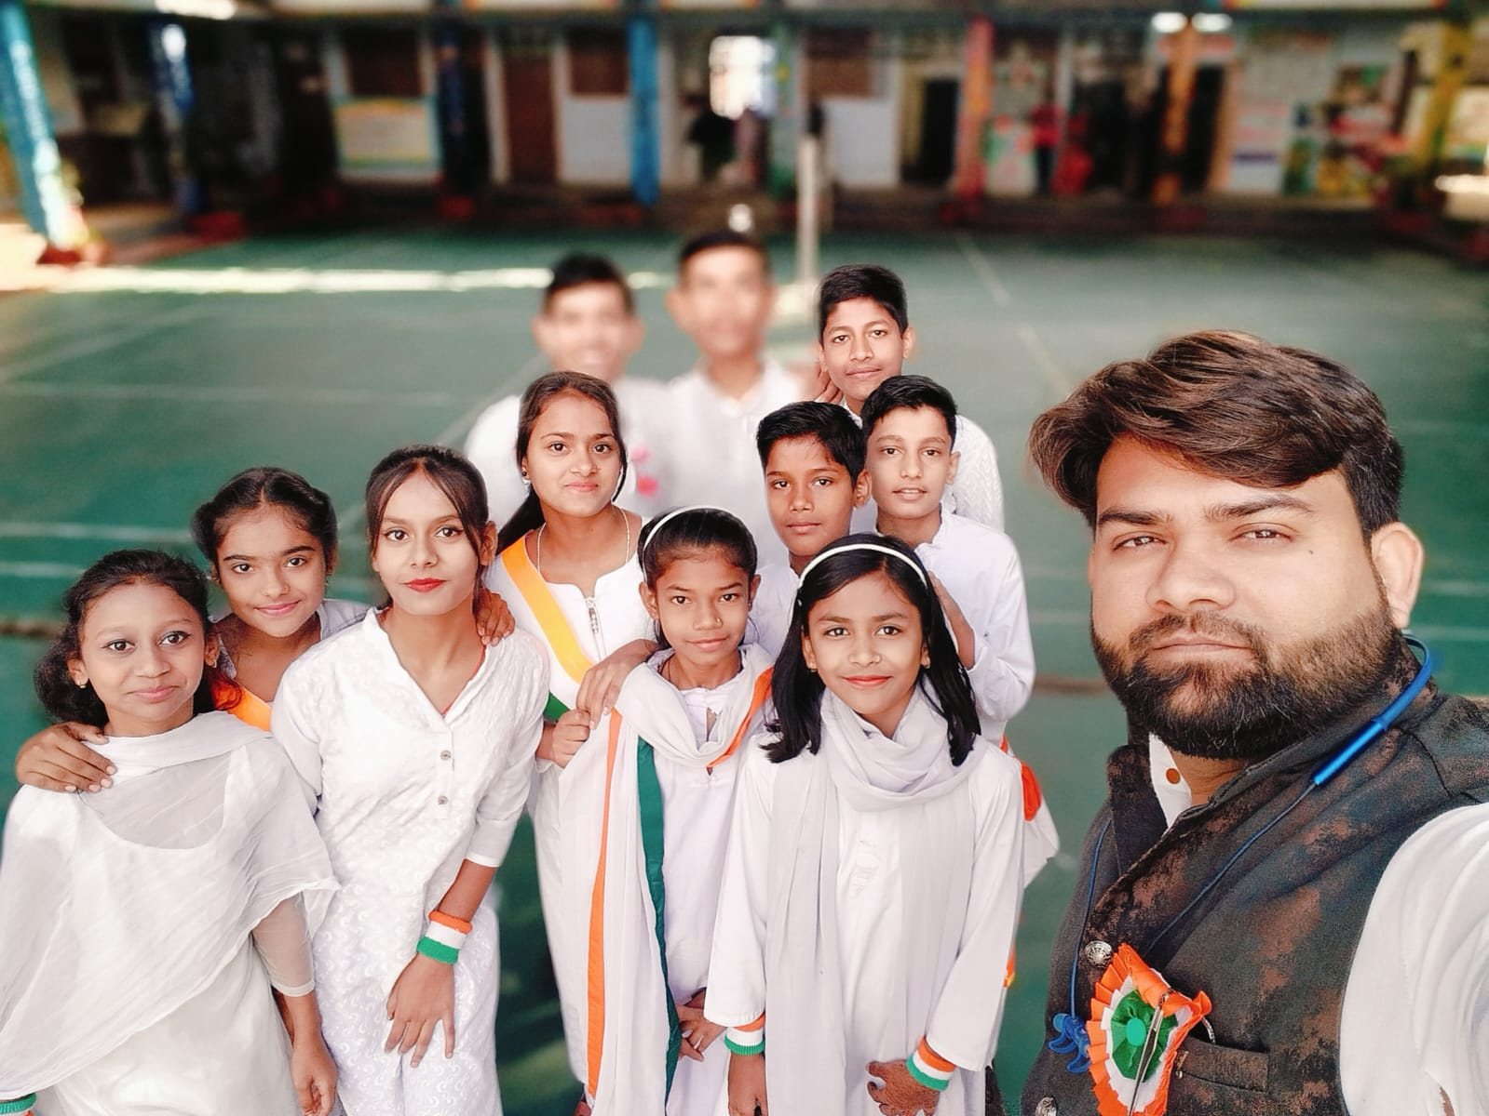

Slide 27
Expected Outcomes
Empower rural & marginalized youth with structured military career training Increased representation of Chhattisgarh students in Defence & Paramilitary
Recruitments Promotion of discipline, leadership,
Fitness culture Establish Chhattisgarh as Centre of Excellence for Pre-Military & Defence training.
Economic upliftment through job-oriented results.

Slide 28
Budget & Implementation
Detailed budget & implementation plan to be finalized after administrative review
Proposal for financial & administrative sanction by Govt. of Chhattisgarh.

Slide 29


Slide 30
Conclusion & Commitment
PMTEAM committed to delivering quality training
Infrastructure management
Regular performance reporting as per government norms
Collaborative effort with District Education Department and Govt. of Chhattisgarh.

Slide 31


Slide 32


Slide 33


Slide 34


Slide 35


Slide 36
CAREER AND TRADE
Career Trades Over view Explore rewarding paths beyond defence with PMTEAM's guidance on vocational skills.
These trades align with India's skill development programs like ITI/NSQF.
Each offers hands-on training, jobs, and entrepreneurship potential.

Slide 37
Agriculture
Pursue farming innovations, crop management, or agribusiness. Tasks include soil testing, irrigation systems, organic farming, and machinery operation for food security roles
Careers:-
Farm manager, agronomist, or seed technician.

Slide 38
Automotive
Trade Focus on vehicle repair, assembly, and electric mobility. Daily work involves diagnostics, engine tuning, brake systems, and EV maintenance
Opportunities:-
Mechanic, service advisor, or auto electrician.

Slide 39
Beauty & Wellness
Master grooming, skincare, and spa therapies. Roles cover hair styling, makeup artistry, salon management, and wellness counselling.
Build a career as stylist, therapist, or salon owner.

Slide 40
BFSI (Banking, Financial Services, Insurance)
Handle finance, loans, insurance policies, and customer advisory.Tasks: Account management, risk assessment, digital banking support, and compliance checks
Paths:-
Banker, agent, or financial analyst

Slide 41
Electronics & Hardware
Repair and assemble circuits, gadgets, and smart devices. Involves soldering, PCB design, troubleshooting, and IoT integration.
Jobs:-
Technician, assembler, or repair specialist.

Slide 42
Telecom
Install networks, maintain towers, and fiber optics. Involves signal testing, equipment setup, and 5G troubleshooting.
Jobs:-
Technician, installer, or network operator.

Slide 43
Media & Entertainment
Create content, edit videos, and manage events.
Tasks:-
Scripting, filming, graphic design, and social media production
Options:-
Anchor, editor, or digital marketer.

Slide 44
Healthcare
Assist in patient care, diagnostics and medical support.
Duties:-
Vital monitoring, lab testing, hygiene protocols, and emergency aid.
Roles:-
Nurse aide, lab tech, or pharmacy assistant.

Slide 45
Plumbing
Design and fix water systems, pipes, and sanitation.
Daily:
Leak repairs, fixture installation, drainage, and safety inspections.
Careers:-
Plumber, supervisor, or contractor.

Slide 46
IT
Develop software, manage networks, and cyber security.
Work on coding, app testing, data analysis, and cloud setup.
Careers:
Programmer, support specialist, or web developer.

Slide 47
Tourism & Hospitality
Manage hotels, tours, and guest services.
Duties:-
Booking, event planning, cuisine service, and travel coordination.
Careers:-
Manager, guide, or chef assistant.

Slide 48
Construction
Civil Construction:-
Build structures, roads, and infrastructure projects.
Work:-
Site surveying, concrete pouring, blueprint reading, and quality checks.
Paths:-
Mason, foreman, or site engineer aide.

Slide 49
Power
Power Trade Operate generators, grids, and renewable energy setups.
Tasks:
Wiring, transformer maintenance, solar panel installation, and load balancing.
Roles:
Electrician, lineman, or energy technician.

Slide 50


Slide 51


Slide 52


Slide 53


Slide 54

Call to ActionChoose defense for patriotism or trades for specialized success – PMTEAM equips you for both.��Contact PMTEAM for training setups and career counseling.Your future starts here!

Slide 55


Slide 56


Slide 57


Slide 58


Slide 59
Call to Action
Call to Action Choose defense for patriotism or trades for specialized success –
PMTEAM equips you for both.
Contact PMTEAM for training setups and career counseling.
Your future starts here!

Slide 60
VOTE OF THANKS
MEETING OF PMTEAM WITH STUDENTS
PHOTOGRAPHS
DISTRIBUTION OF RETURN GIFTS AND REFRESHMENTS
STANDUP FOR NATIONAL ANTHEM ( MANDATORY TO BE ATTENDED BY ALL)
FOLLOWED BY PATRIOTIC SLOGANS
JAI HIND
www.pmteam.in

